Slide 1
Springfield Property manager
Week 3: 7/26/2020
7/20/2020 through 7/26/2020
75
13

Slide 2
Springfield property manager Code
Bariskoklu
AI: People move to the property they desire
People get very hungry at the start of the month
Vince McKeown
Opening Story
People’s dialog
Mdfewkes
Sound Engine
Gabriel Cornish
Day Counter

Slide 3

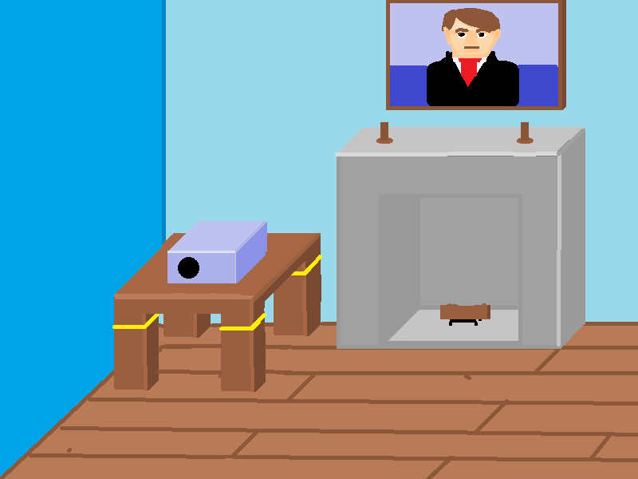
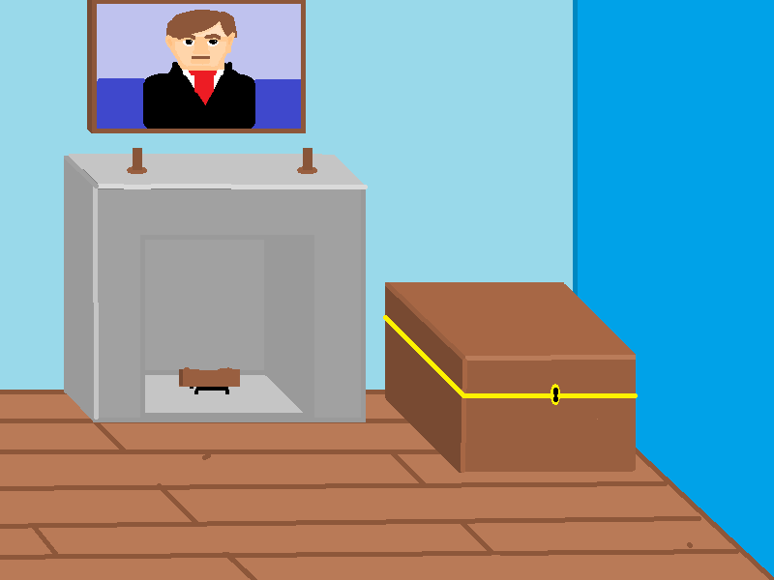
Springfield property manager Code
Casio101
Brazilian Steakhouse
Vince McKeown
Basic Office Building
Gabriel Cornish
Unified Color Palette

